Slide 1

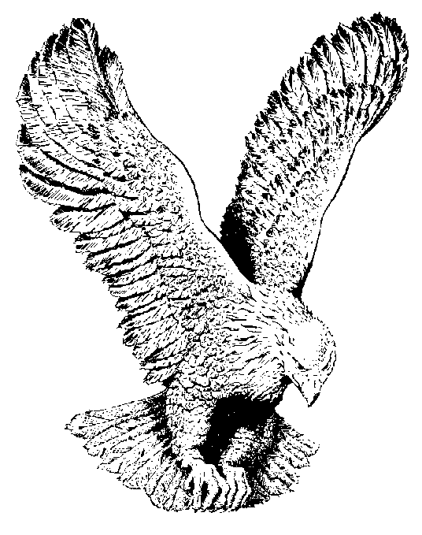
HE IS LORD
Jehovah of the old testament is Jesus Christ of the new testament,
My Lord my God, is Jehovah the almighty.

Slide 2
He has been given a name above all names,
Every knee shall bow and every tongue confess.
He has been given a name above all names that Jesus Christ is the Lord.

Slide 3
He is Lord (2x) Amen,
He has risen from the dead, He is Lord.
Every knee shall bow, every tongue confess that
Jesus Christ is Lord.

